Slide 1
CSS
box model

Slide 2
the box model
All elements on a web page can be considered as blocks or boxes!
2 types of boxes:
block level
inline

Slide 3
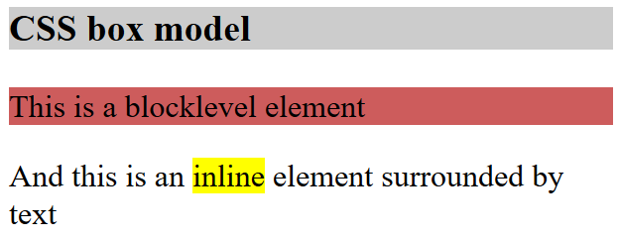
Block level elements
takes up the full width available
automatically preceded and followed by a line break
examples:
<div>
<h1> - <h6>
<p>
<form>
<header>
<footer>
<section>

Slide 4
Inline elementen
only takes up as much width as necessary
does not enforce line breaks.
examples:
<span>
<a>
<img>

Slide 5
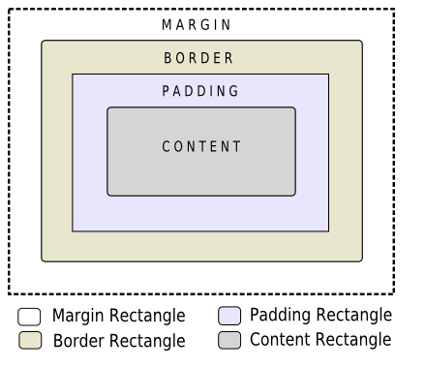
the box model
Width of parent element
Margin of
element
Border
Padding of
element
Height
of
parent
element
Height
of element
text and/or images
Width of element

Slide 6
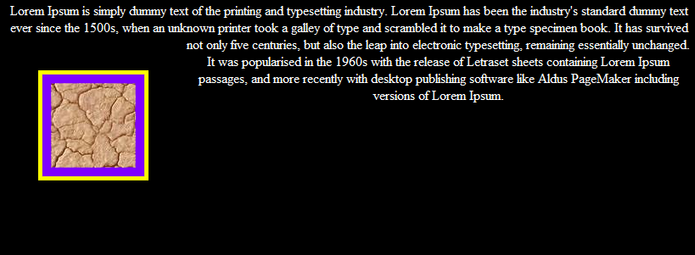
Het box model
img
{
width: 40px;
border: 5px solid yellow;
padding: 10px;
margin: 20px;
background-color: purple
}
What is the total width of this box?
width= 40px +2*10px+2*5px+2*20px
= 110 px

Slide 7
Visual formatting model
property | Value | Description
display | none | The element will not be displayed at all
 | block | The element is displayed as a block-level element (like paragraphs and headers)
 | inline | This is default. The element is displayed as an inline-level element (like span)
block:
starts on a new line, starting from the left side of the page
takes up full width of page
inline:
shown ‘on the line’
multiple adjacent boxes are possible as long as there is space left on the line

Slide 8
Visual formatting model
in CSS define the type of box
a{display:inline;} -> inline is standard
a{display:block;}
By default, links are inline elements (are placed next to each other)
using display:block; changed the behavior of links and places them under each other (e.g.: menu)

Slide 9
Visual formatting model
display: none;
hides the element
element does not take up any space on the page
as if it has never existed
visibility: visible; (standard value)
visibility: hidden;
hides an element
element does take up space on the page
as if it were present

Slide 10
remark
What is the difference?
display:none;
visibility:hidden;

Slide 11
Margin
property | Value
margin | … px … cm … in … mm … % auto
margin-left margin-right margin-top margin-bottom | …
combined:
p {margin: 5px 2px 5px 3px}
top right bottom left

Slide 12
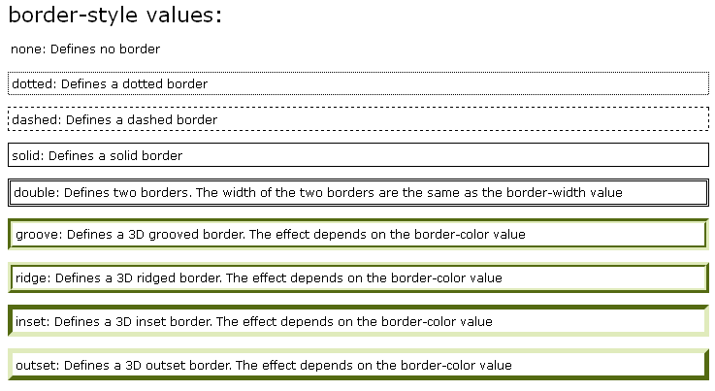
Border

Slide 13
Border
border-width | px, cm, in, mm, %, auto
border-left-width border-right-width border-top-width border-bottom-width
border-color | #000000 ... #FFFFFF
border-left-color border-right-color border-top-color border-bottom-color
border-style | none, dotted, dashed, solid, double, groove, ridge, inset, outset
border-left-style border-right-style border-top-style border-bottom-style
Shorthand notation:
border: 1px solid blue;

Slide 14
Padding
Property | Value
padding | … px … cm … in … mm … % auto
padding-left padding-right padding-top padding-bottom | …
combined:
p {padding: 5px 2px 5px 3px}
top right bottom left

Slide 15
content
Kenmerk | Value
width height | … px … cm … in … mm … % auto
% is with respect to first block-element that surrounds this element
width box= width + padding (l and r) + border (l and r) + margin (l and r)

Slide 16
example
img{
width:200px;
border:5px solid red;
margin:50px;
padding:30px;
background-color:blue
}
<!doctype html>
<html>
<head>
<meta charset="UTF-8" />
<title>CSS-box-model</title>
<link href="style_boxmodel.css" rel="stylesheet" />
</head>
<body>
<h3>CSS box model</h3>
<p>
<img src="mapOfBelgium.gif" alt="map of Belgium;" title="map of Belgium" />
Map of Belgium
</p>
</body>
</html>
Predict the page layout

Slide 17
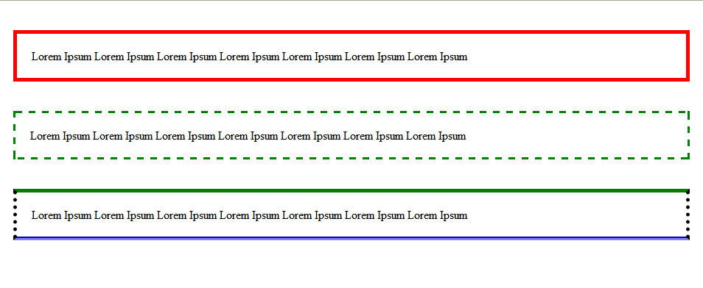
exercise Borders, padding, margin
create 3 paragraphs with different borders
all paragraphs have a 20px padding
the spaces around the paragraphs (margin) are:
top&bottom: 40px
left&right: 10px;
Write as little CSS as possible

Slide 18
exercise
In css:
.wrapper{width:600px;margin:auto;border:1px solid black;}
.div1{border:1px solid black}
.div2{height:100px;border:1px solid black;}
img{width:200px;height:100px;border:1px solid black;}
#img1{padding:50px;}
#img2{margin-left:100px}
#img3{float:left}
<!DOCTYPE HTML>
<html>
…
<body>
<div class="wrapper">
<div class="div1">
<img id="img1" src="rect1.jpg" alt="rectangle 1" />
<img id="img2" src="rect2.jpg" alt="rectangle 2" />
</div>
<div class="div2">
<img id="img3" src="rect1.jpg" alt="rectangle 1" />
Text is placed here
</div>
</div>
</body>
</html>
1
2
Sketch in the browser window below, with dimensions 800px X 600px, what will be shown when opening the HTML file above in Chrome or Firefox.

